Slide 1
Tryout Meeting
Please check in with the coaches before taking a seat!

Slide 2
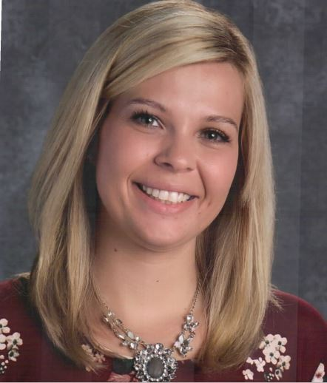
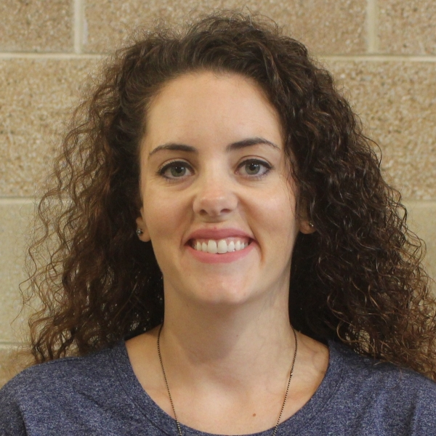
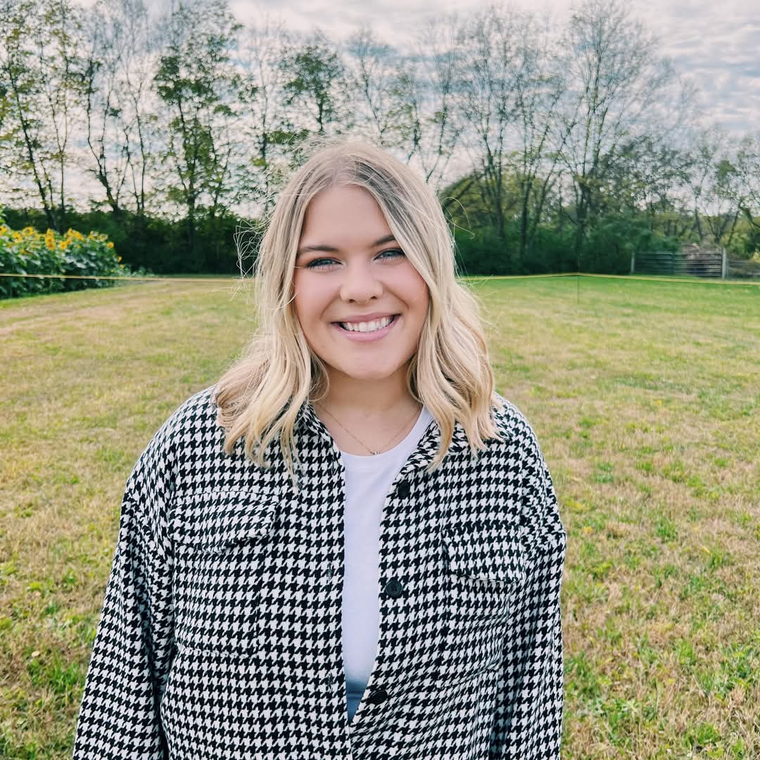
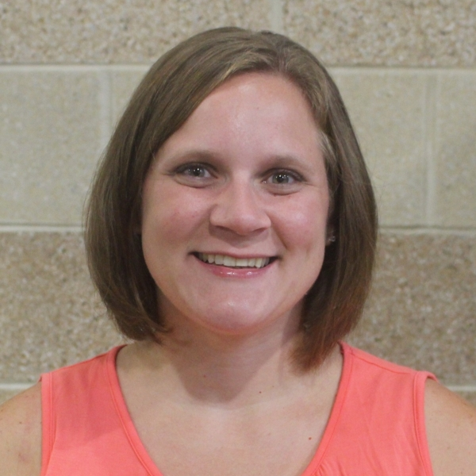
Cheerleading Coaches
Stephanie Ramsey, Head Coach
Administrative Assistant at Southwest Early Childhood Learning Center
Allison Krabbe, Assistant Coach
Teacher at Harrison Elementary
Molly Hasenohr, Junior School Coach
Teacher at Harrison High School
Lydia Leverett, Assistant Coach
Teacher at Miami Whitewater Elementary

Slide 3
Tryouts
Material review days to teach/review Tryout material-
  Thursday and Friday May 14 & 15
  Junior School- 7th and 8th grade 3-4:30pm
  High School 4:30-6pm
  High School May 14- 9th and 10th grade only
  High School May 15- 11th and 12th grade only
Tryouts –
Saturday May 16
Junior School 9am-11am
High School- 11am-1:30pm
Team postings by 6pm Saturday
Athletes send acceptance emails to coaches by 9pm Saturday
**Tryouts are closed to the public

Slide 4
What to wear
JS: white shirt / black shorts, gym shoes, hair pulled up, no jewelry
HS: green shirt / black shorts, gym shoes, hair pulled up, no jewelry

Slide 5
Material
Material can be found online – southwestschools.org/cheerleading on the Tryout Material page and on our you tube page @HHS-Cheer
Also, links are posted on our Facebook page – William Henry Harrison High School Cheerleading

Slide 6
Handbook/Fundraising events
Core Values / no drugs or alcohol / follow all school rules
Absences policy – 2 per season / does not include: summer camps/ games/competitions/ choreography
**ALL FUNDRAISING IS MANDATORY**
Cincinnati Open Tennis Tournament – Aug. 11 – Aug. 23 / 2 shifts per family / first come first serve sign up – details will be shared to those that make the team.
Cheer Classic – October 18th – ALL DAY/ athlete plus 1 adult
Harrison Athletic Boosters – must become a member AND JS work 2hrs per season / HS work 4hrs per season
Payments /Price sheet with payment dates/details in Handbook- Coaches will post price sheet on team Parent Square with those that make the team

Slide 7
High School Cheer Teams
Teams may look a little different this year- options:
Freshman/JV/ Varsity
JV-B/ JV-A/ Varsity
Some may only make 1 season vs. what they requested/signed up for.
-Example: if you signed up for Football and Basketball season- we may only be able to offer you football season.
Different set up to be able to keep as many athletes as we can. We will not know for sure until Tryout day but wanted to be as transparent as possible.

Slide 8
High School Summer practices
Sideline Summer practice/weights starts June 2nd:
  Sideline practice-Tuesdays 9am-12pm (Weights 9am-945am)
Competition practice- May 18-3:30-5:30/ May 19-430-6pm /May 26-9am-12pm
Competition practice- starting June 3rd-Wednesdays 9-11am
MANDATORY Competition Choreography:
Traditional: May 27 & 28 9am-4pm
Game Day- June 17 8am-12pm
School year Sideline/comp practices will begin the week of August 3rd:
Sideline- Monday & Wednesdays-430-6
Competition-Tuesdays-4-6

Slide 9
Junior School Summer Practices and Teams
7th grade will cheer 7th grade home football and basketball games
8th grade will cheer 8th grade home football and basketball games
Practice: May 19 from 3:00-4:30 in cheer room
Competition Team Choreography: June 17 from 1-4pm in cheer room
Practice: July 21, 22, 23 from 8:00-10:00am
Practice August 4, 5, 6 from 8:00-10:00am
School year practice begins the week of 8/17 and will be weekly Mondays and Wednesdays from 3:00-4:30pm

Slide 10
Summer Camps
ALL SUMMER CAMPS ARE MANDATORY for Junior School and High School
Youth Cheer camp- June 15,16,17,18 @ 1-3pm @ AC and HS old gym
  Junior School Cheerleaders will attend as a team- no need to register
UCA camp- July 27,28,29,30-@ Great Wolf Lodge * This is a closed event and we are asking families to not book rooms during our stay.

Slide 11
Questions for the group?
Coaches will also stay afterwards to answer any individual questions

